Slide 1

ROUND 2 UNIVERSITY STUDENT CATEGORY
AITEK
AutoMate: Make Your Drive, Make Your Style
Email: aitek.automate@gmail.com
Hotline: 0703 536 941
Address: HCMUT

Slide 2
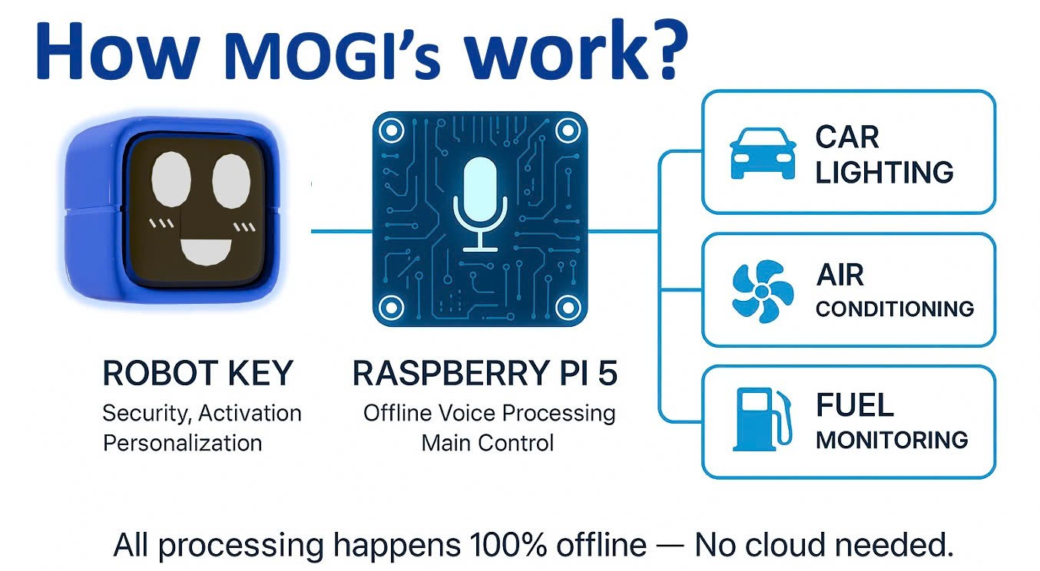
1. INNOVATION
How MOGI’s work?

Slide 3


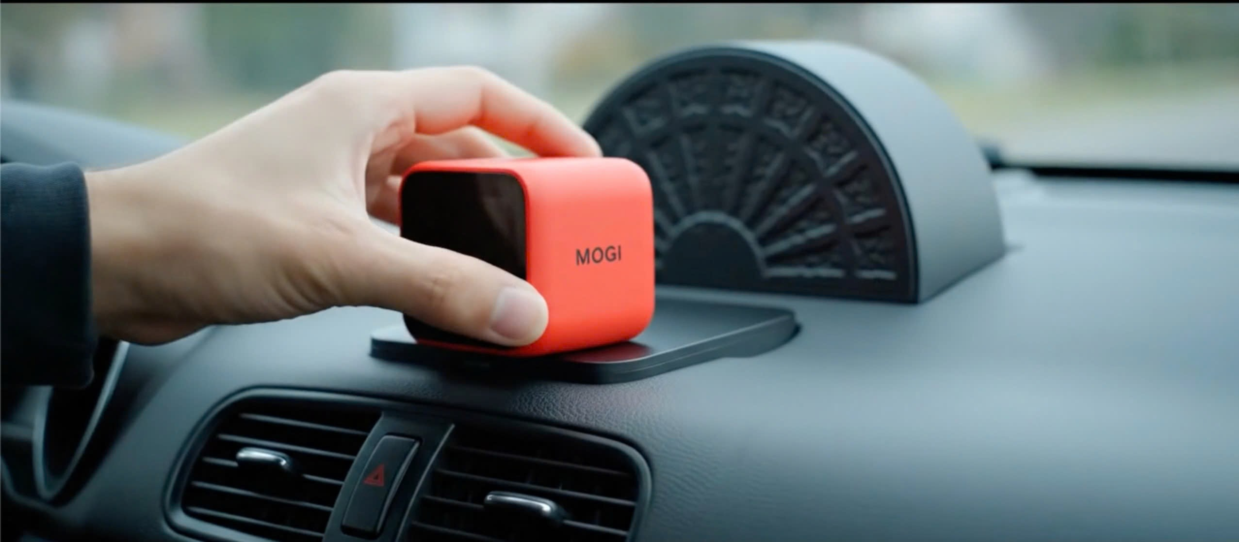

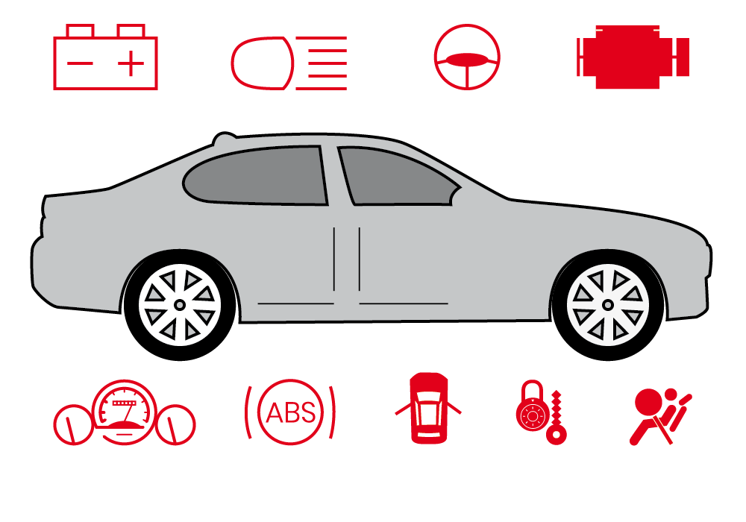
2. INNOVATION
100% Offline Voice Control
Unique “Robot Key” Interface
More Stable and Easier to Use
Interactive robot key – simple, fun, and personal
MOGI
Deep Hardware Integration
Smart Add-on
Built-in smart control connection to your car
Turn any car into a smart car – at a price you can afford

Slide 4

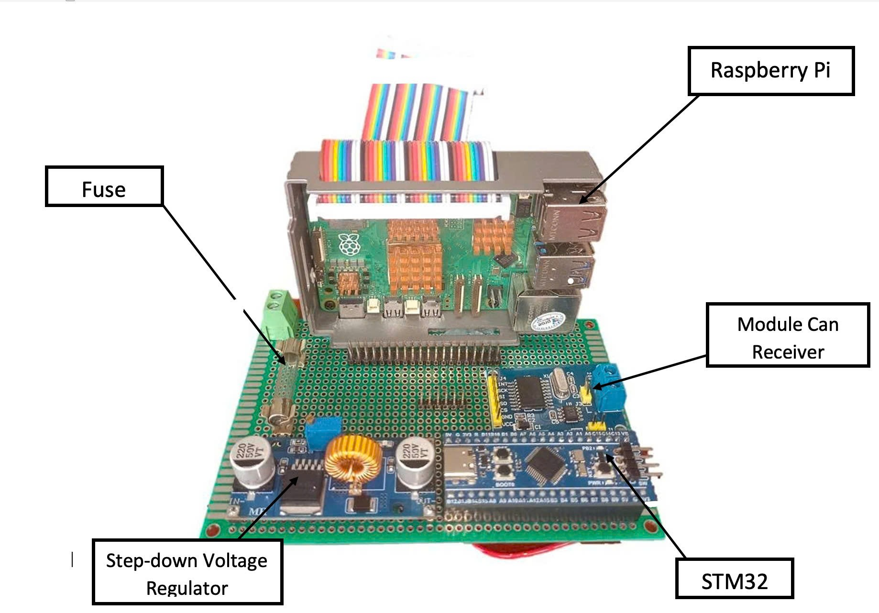
2. PROTOTYPE
3D Model Standard

Slide 5

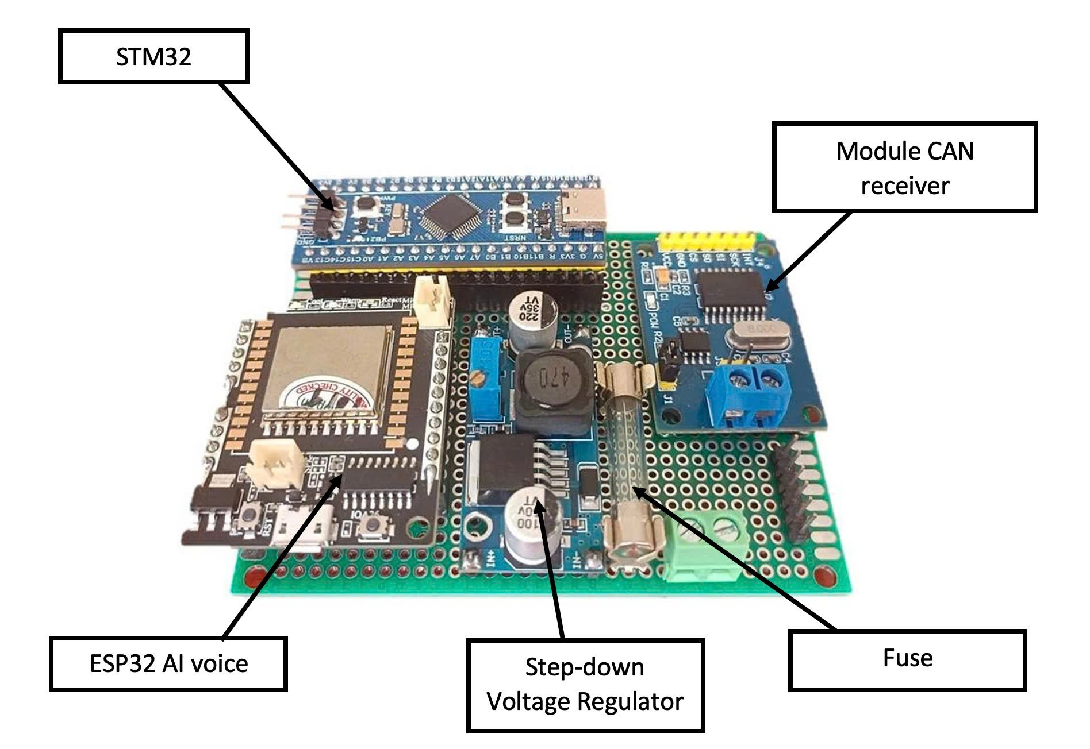
2. PROTOTYPE
3D Model Lite

Slide 6

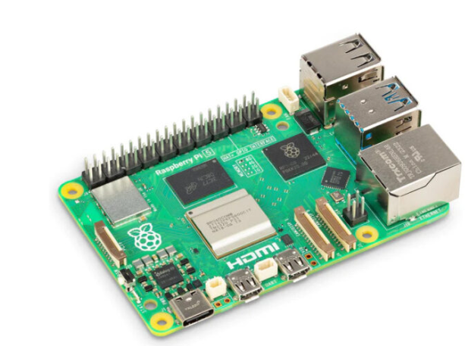
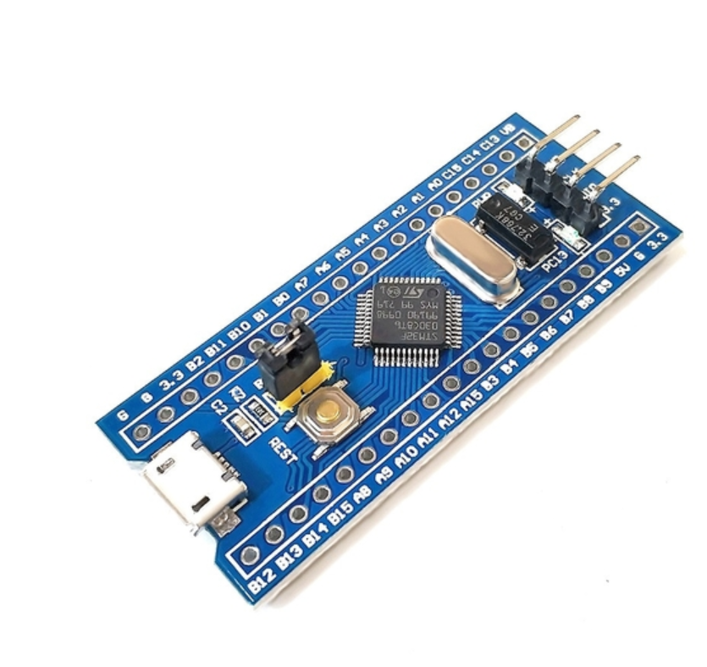
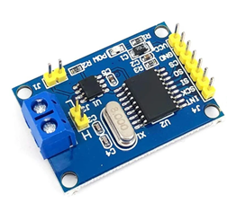

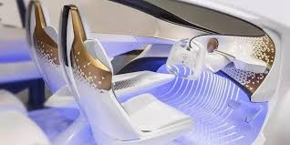
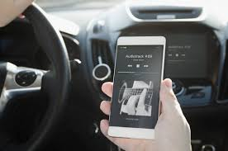
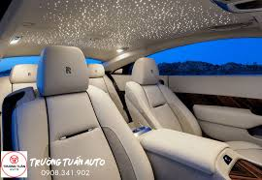
2. PROTOTYPE
OLED – MOGI FACE
Raspberry pi 5
STM32
Warning System
CAN bus
Air Conditioner
General Layout
Music volume
Light

Slide 7
3. MARKET FEASIBILITY
 | 2023 Q1 | 2024 Q1 | 2025 Q1 | Change (2024→2025)
VAMA total vehicle sales | ~70,392 units | ~58,165 units (↓17%) | 72,249 units (↑24%) | +24%
Passenger car sales (VAMA members) | ~52,712 units | ~41,858 units (↓21%) | 51,089 units (↑22%) | +22%
VinFast BEV domestic deliveries | - | - | 35,100 units | -
EV + Hybrid share of total car sales | ~15–20% | ~15–20% (est.) | ~15–20% (forecast) | Stable
EV market size (2025 value est.) | - | - | 3.12 billion USD | CAGR ~18.9% to 2030
These strong trends and government support create an ideal environment for EV growth and related tech. AutoMate, being offline, affordable, and hardware-integrated, is perfectly positioned to serve both traditional cars and new EVs, without relying on internet or high prices.
Sources: VAMA, Vietnam News Agency, Reuters, Mordor Intelligence (2023–2025)

Slide 8





3. MARKET FEASIBILITY
Market Needs
Target Market
What drivers are really looking for ?
People want safer driving
They need smart features that work offline
They prefer simple, easy-to-use systems in the car
Who is this made for?
Drivers who love tech and live in the city
People who often lose internet while driving
Car owners who want to upgrade old vehicles
ride-hailing drivers needing smarter tools
MOGI
Supportive Trends
TAM ~ 580M $
Why Now Is the Right Time for Smarter, Safer Cars ?
People care more about driving safely
Smart Car Adoption & Personalization
Offline AI is growing fast – no internet, but still smart
SAM ~ 71M $
SOM
2%

Slide 9
3. MARKET FEASIBILITY
S
STRENGTHS
• Stable offline voice
•Friendly, robot-like design that’s customizable.
• Broad compatibility
• Modular hardware for easy mainteinance.
• Compact and stylish – enhances the car’s interior look
W
WEAKNESS
• High production cost at small scale.
• Limited voice command vocabulary (early stage).
• Installation may require wiring expertise.
•User experience (UX) still needs improvement
O
OPPORTUNITIES
• Growing ride-hailing and car rental services
• Supportive policies for local tech startups.
• Rising interest in traffic safety and smart mobility.
• Potential for education or training partnerships.
T
THREATS
• User preference for built-in assistants (Google, Siri).
• Risk of chip shortages or supply chain delays
• Some users may be skeptical of aftermarket add-ons
• Competitors may copy the idea after launch

Slide 10


3. MARKET FEASIBILITY
Criteria | AutoMate | VinFast ViVi | NOMI / Chinese EVs | Mercedes MBUX
Offline capability
Hardware-level control
Retrofit / Old car support
Vietnamese voice support
User installation
Reputation
Estimated cost
Best suited for... | Flexible vehicles | VinFast owners | EV drivers valuing UI aesthetics | High-end infotainment users

Slide 11








3. MARKET FEASIBILITY
High price
Competitive matrix
Low quality
High quality
Low price

Slide 12
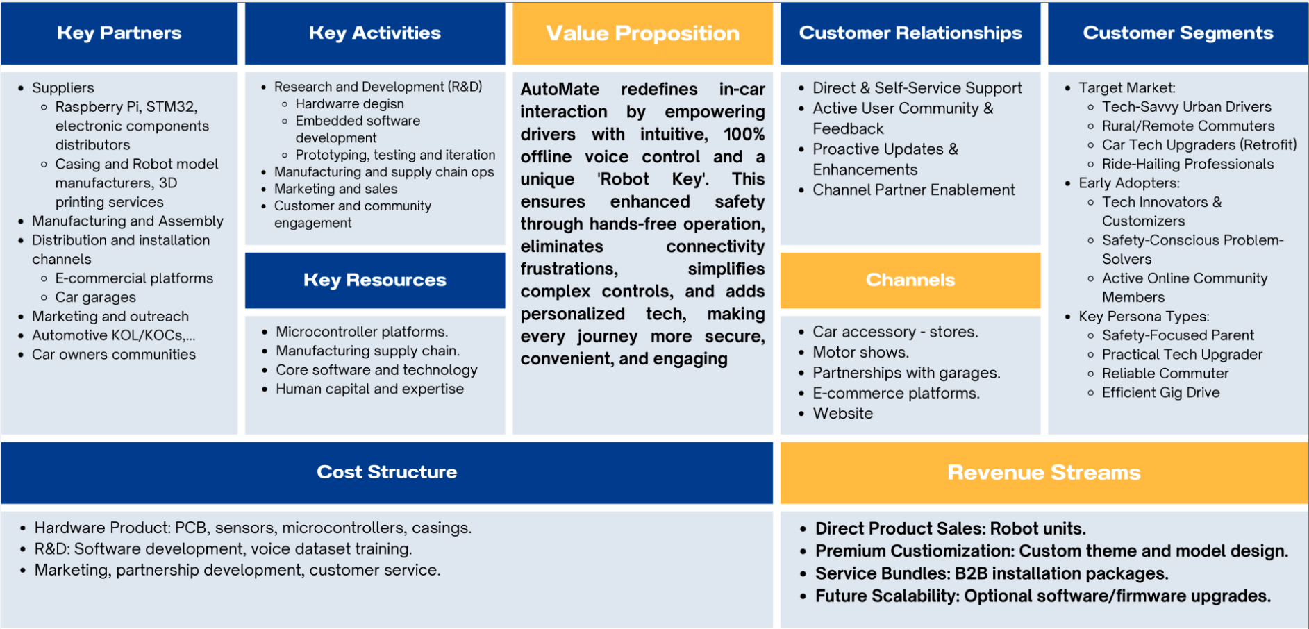
4. BUSSINESS MODEL

Slide 13
4. BUSSINESS MODEL
PRICE LIST
MOGI standard | 2,999,000
MOGI lite | 999,000
Robot Key – Pre-designed | 249,000
Robot Key – Custom Design | 799,000 – 999,000
Software Upgrade | 349,000
Currency unit: VND

Slide 14
4. BUSSINESS MODEL
Profit Contribution | Pessimistic | Base-Case | Optimistic
Profit from Main Product | 1,199M | 1,199M | 1,199M
Expected Profit from Robot Key | 34,860 | 69,720 | 95,865
Expected Profit from Design Service | 11,186 | 27,965 | 44,744
Expected Profit from Software | 33,155 | 66,310 | 99,465
TOTAL LTV (Gross Profit) | 1,278,801 | 1,363,595 | 1,439,674
Estimated Lifetime Value of an Acquired Customer - LTV
Currency unit: VND

Slide 15
4. BUSSINESS MODEL
COCA (Year 1) 400,000 VND/customer
*Cost-of Customer-Acquisition
In line with Vietnam’s smart device & automotive accessory market, where typical first-year COCA ranges from 300,000–700,000 VND/customer (Do Ventures 2022, Statista IoT Market Data)
LTV range Estimated to be between
~VND 1.28 million and ~VND 1.44 million
LTV/COCA ratio Ranges from 3.2 to 3.6
An LTV/COCA ratio greater than 3
*Live-time value per customer

Slide 16
4. BUSSINESS MODEL
Revenue
YEAR | Lite units | Standard units | Lite Revenue | Standard Revenue | Robot Key Revenue | Custom Revenue | Upgrade Revenue | Total revenue
1 | 1200 | 300 | 1,198,800 | 899,700 | 29,880 | 13,485 | 20,940 | 2162805
2 | 1200 | 750 | 1,198,800 | 2,249,250 | 74,700 | 33,712.50 | 52,350 | 3608812.5
3 | 1400 | 950 | 1,398,600 | 2,849,050 | 94,620 | 42,702.50 | 66,310 | 4451282.5
Revenue projection in 3 years
Currency unit: thousand VND

Slide 17
4. BUSSINESS MODEL
Costs
YEAR | Lite units | Standard Units | FIXED |  |  |  | VARIABLE |  |  |  |  | TOTAL
 |  |  | Utilities | Personel | Depreciation | Software Update | Materials | Tax | Logistic | Marketing | Online Transaction Fee
1 | 1200 | 300 | 30,000 | 60,000 | 20,000 | 5,000 | 780,000 | 64,884 | 51,000 | 81,000 | 24,000 | 1,115,884
2 | 1200 | 750 | 35,000 | 80,000 | 20,000 | 5,000 | 1,230,000 | 108,264 | 73,500 | 112,500 | 33,000 | 1,697,264
3 | 1400 | 950 | 40,000 | 100,000 | 20,000 | 7,000 | 1,510,000 | 133,538 | 89,500 | 136,500 | 40,000 | 2,076,538
Currency unit: thousand VND
Cost projection in 3 years

Slide 18
4. BUSSINESS MODEL
Year | Profit
0 | - 300,000
1 | 746,921
2 | 2,658,469
3 | 5,033,213
Profit projection in 3 years
Currency unit: thousand VND

Slide 19
4. BUSSINESS MODEL
Top 10 Best-Selling Cars in Vietnam (First Half of 2025)
Rank | Car Model | Units Sold
1 | VinFast VF 3 | 22,895
2 | VinFast VF 5 | 21,814
3 | Mitsubishi Xpander | 8,187
4 | Ford Ranger | 7,785
5 | VinFast VF 6 | 7,501
6 | Mazda CX-5 | 7,384
7 | Toyota Yaris Cross | 5,420
8 | Toyota Vios | 5,265
9 | Ford Everest | 5,134
10 | Ford Territory | 3,630
Total |  | 94,015
Most top-selling cars lack advanced voice-assistant features, creating a clear opportunity for AutoMate to provide smart, voice-enabled in-car experiences.
Sources: VAMA, VinFast; VnExpress, July 16, 2025

Slide 20



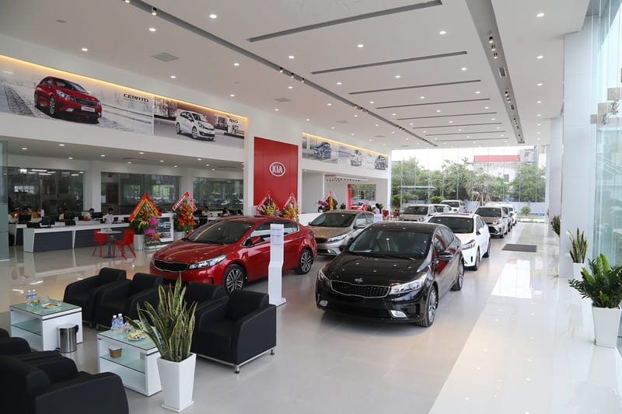

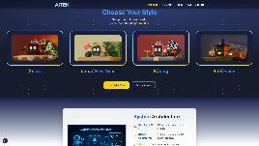

4. BUSSINESS MODEL
TRADITIONAL CHANNEL
CONTEMPORARY
E-commerce
platforms
Motor shows
Car accessory - stores
Website

Slide 21
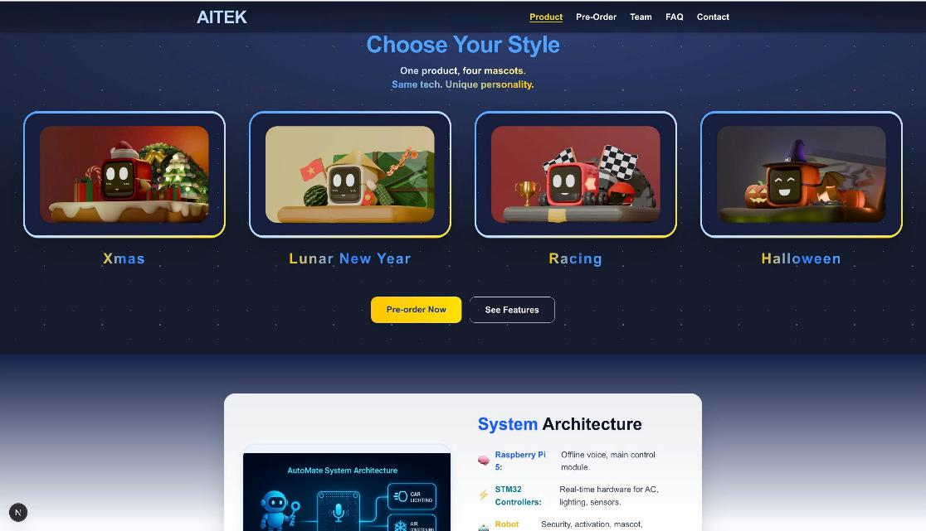

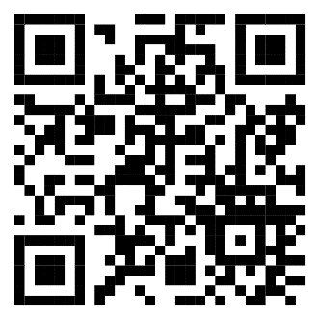
4. BUSSINESS MODEL
Scan this QR code to access our website, AITEK!

Slide 22


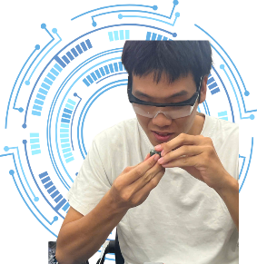



5. TEAM & ADVIDORS
AITEK: Dedicated Automotive Engineering Students from HCMUT
Team Leader: Tieu Chi
Embedded Software Development
Vehicle Interface Integration
Thuy Tien
Hardware Developer
Minh Duy
Software Developer
Mentor: Mr. P.T Dang Quang
Lecturer at the Faculty of Transportation
Guidance: Transportation Engineering & Electronic Field
Nang Tri
Team Spokesperson
Tien Dung
Market Analyst

